Slide 1

VOCABULARY BUILDER & SMART FLASHCARDS APP
Group Members:
Oluwafikolami Ejidare
Chigozirim Akuwudike
Yaseer Maruf
Michael Braimah
Oluwatobi Adewola

Slide 2
INTRODUCTION
Vocabulary is the collection of words a person knows and uses.
It is important for communication and learning.
Memorization of new words can be difficult
This application helps users learn new words using AI, smart flashcards and quizzes.

Slide 3
AIM OF THE PROJECT
To develop an intelligent vocabulary learning application (beginner-friendly) that helps users understand, memorize, and test their knowledge of words.

Slide 4
OBJECTIVES/ FUNCTIONAL REQUIREMENTS OF THE PROJECT
Search for words.
Generate explanations using AI.
Save words as flashcards.
Review flashcards.
Take quizzes.
Store quiz scores.

Slide 5
NON-FUNCTIONAL REQUIREMENTS OF THE PROJECT
Usability & Simplicity.
Reliability & Error handling.
Maintainability – avoid duplicates, use of functions and modules etc.
Efficiency – processing power, memory allocation, time management.
Portability – cross-platforms.

Slide 6
TECHNOLOGIES USED
Python.
Streamlit.
Gemini AI.
JSON.
Object-Oriented Programming.
Dictionary API.
Git & GitHub.

Slide 7
RECOMMENDATIONS
User Authentication – login functionalities.
Performance of quiz visualization – charts & statistics displaying progress over time.
Better flashcard management – delete, edit, organize/sort.
Multiple quiz formats.

Slide 8
FEW SNAPSHOT OF CODES

Slide 9
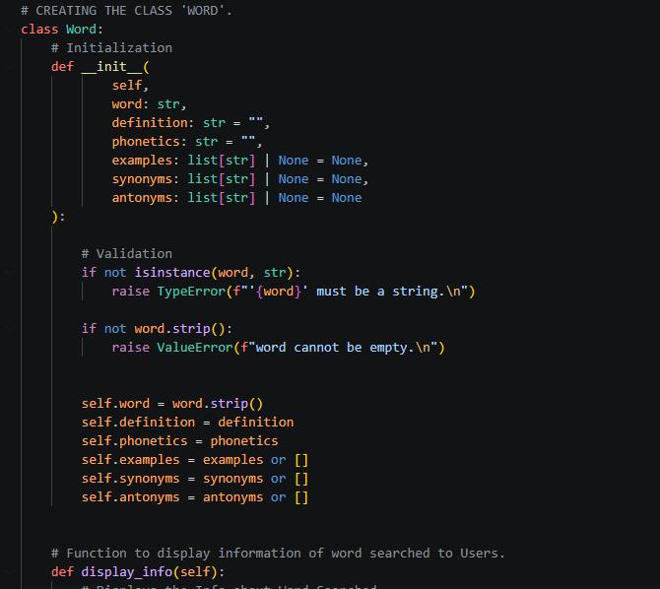
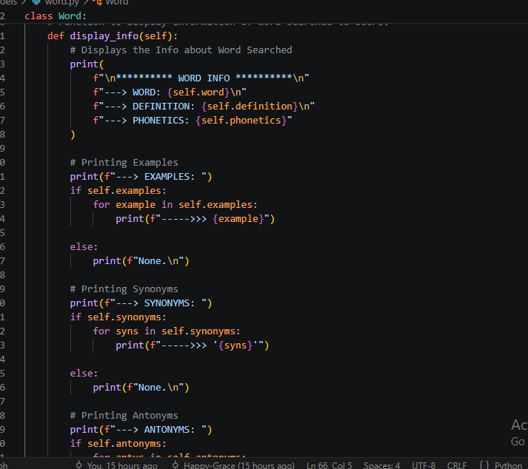
models → word.py

Slide 10
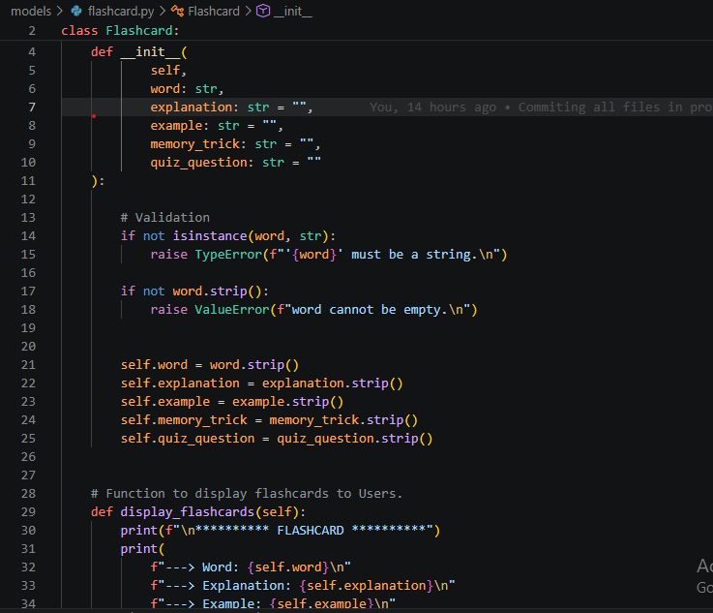
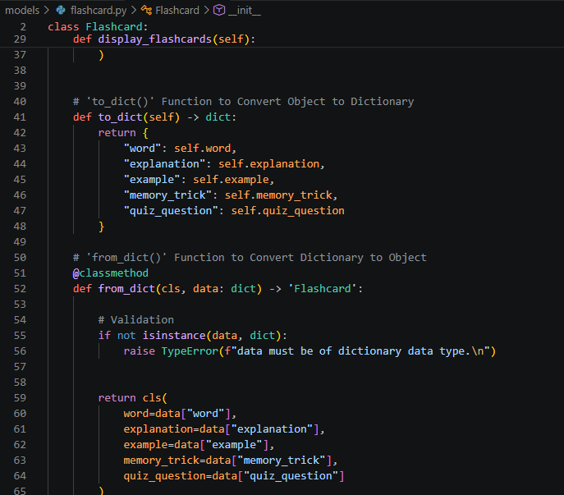
models → flashcard.py

Slide 11
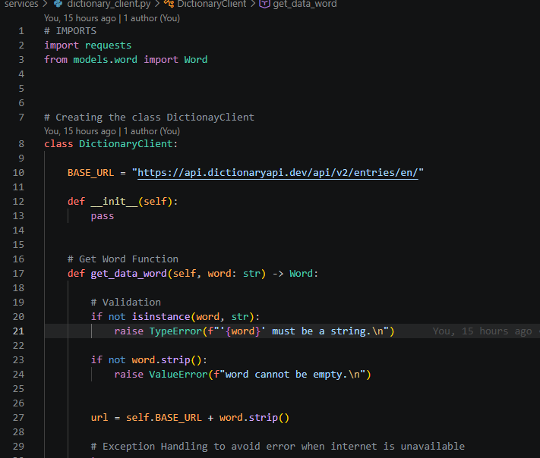
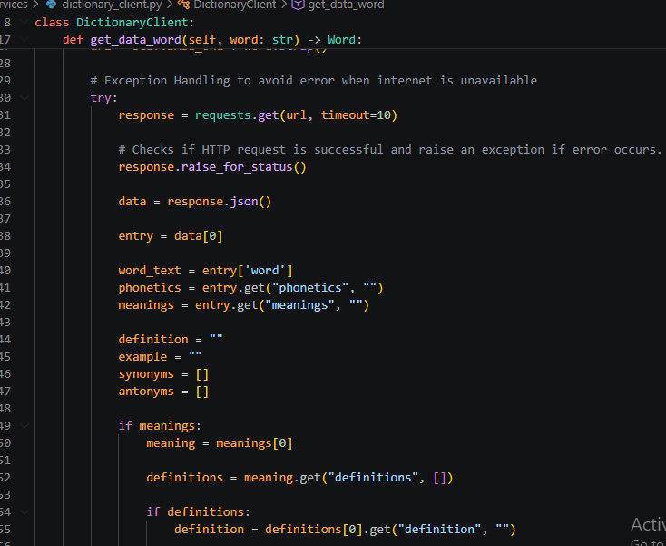
services → dictionary_client.py

Slide 12
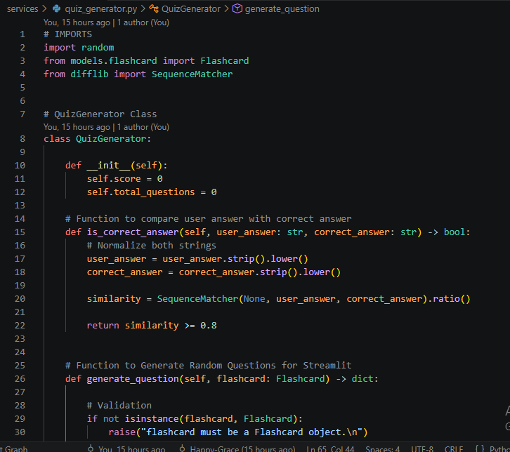
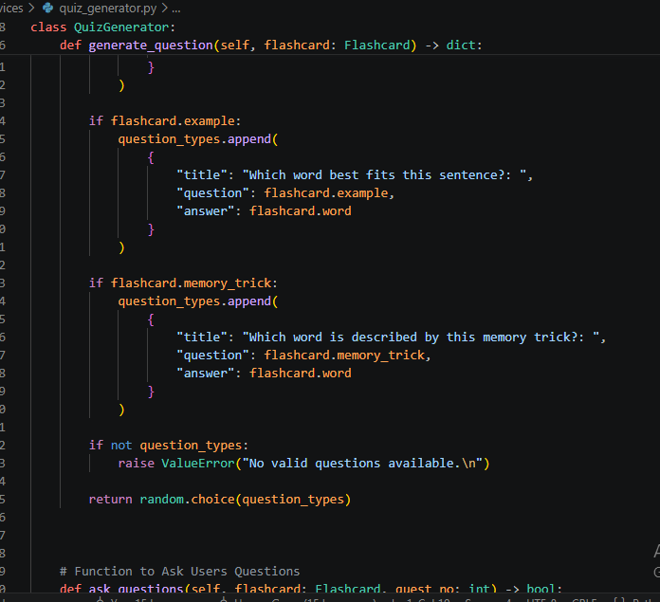
services → quiz_generator.py

Slide 13
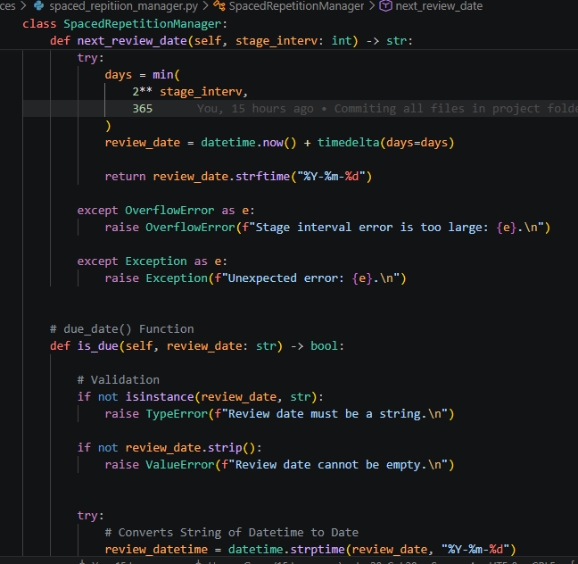
services → spaced_repetition_manager.py

Slide 14
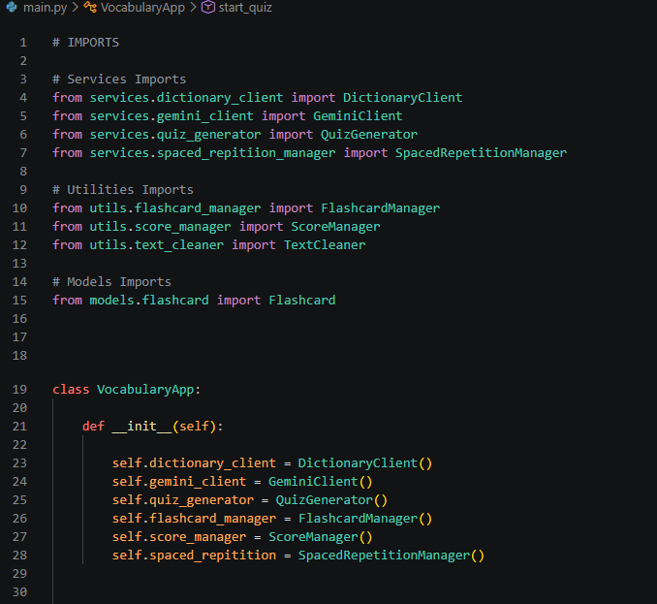
main.py

Slide 15
DEMONSTRATION

Slide 16
THANK YOU!!

